Slide 1
Digital Systems and Computer Architecture Session 3.2 Mouli Sankaran
Module 3
Analysis of Clocked Sequential Circuits

Slide 2
Session 3.2: Focus
Types of Sequential Circuits
Analysis of Clocked Sequential Circuits
Logic Diagram
State equations
State Table
State Diagram
Example 1: Moore Machine
Example 2: Mealy Machine

Slide 3
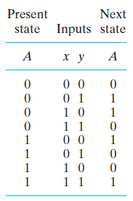
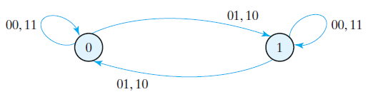
Example : State Diagram
Note: Since output is same as the present state,
It is not shown separately in the state diagram
The information available in a state table can be represented graphically in the form of a state diagram.
A state is represented by a circle, and the (clock-triggered) transitions between states are indicated by directed lines connecting the circles
Along with inputs that trigger the transitions)

Slide 4
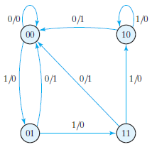

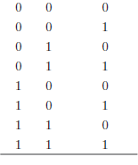
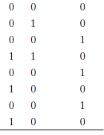
Example : State Diagram
State Table
State Diagram
This circuit acts as a 0-detector by asserting its output when a 0 is detected in a stream of 1s

Slide 5
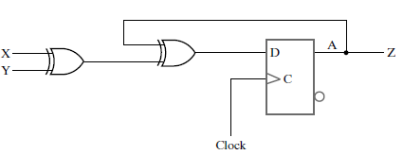
Example 1.3: State Table
The time sequence of inputs, outputs, and flip-flop states can be enumerated in a state table
Also called as a transition table
Next state for all possible combinations of present states and inputs are defined
Z
Z is an Odd function
Z = 1, when there are
odd number of inputs

Slide 6
State Diagram Explained
The state diagram provides the same information as the state table and is obtained directly from the state table
The binary number inside each circle identifies the state of the flip-flops.
The directed lines are labelled with two binary numbers separated by a slash.
The input value during the present state is labelled first, and the number after the slash gives the output during the present state with the given input (shown in Example 2)
It is important to remember that the bit value listed for the output along the directed line occurs during the present state and with the indicated input
It has nothing to do with the transition to the next state.

Slide 7
Steps in the Analysis
Circuit/Logic Diagram
State Equations
State Table
State Diagram
2
State equation
1
Logic diagram
3
State table
4
State diagram

Slide 8

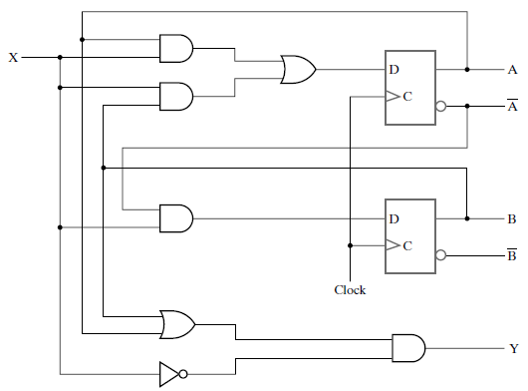

Example : State Equations
Next state values:
2.1 Logic Diagram
More convenient form:
X
A
X
=
=
Output equation:
A
More convenient form:
B
B
Y
Y
Mealy Machine

Slide 9
Example : State Table
Logic Diagram
State Table
X
A
A
B
B
Y
State Equations
=
=

Slide 10
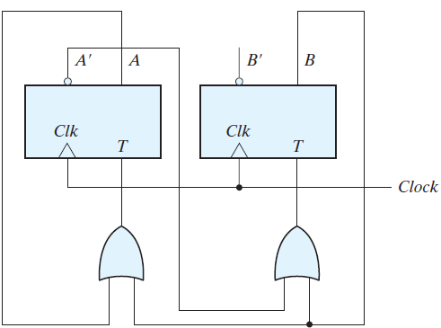


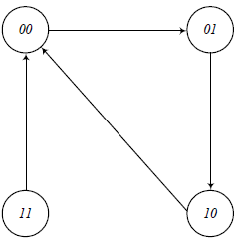
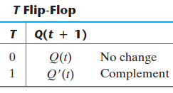

Problem 1: State Table and State Diagram
Give the state table and state diagram of the circuit below:
Initial state is 00
Flip-flop inputs:
T_{A}=
A + B
T_{B} =
A’ + B
State table:
T_{A}
T_{B}
1

Slide 11
Session 3.2: Summary
Types of Sequential Circuits
Analysis of Clocked Sequential Circuits
Logic Diagram
State equations
State Table
State Diagram
Example 1: Moore Machine
Example 2: Mealy Machine

